Slide 1
Edge / Boundary Detection
Szeliski 4.2
Computer Vision
CS 143, Brown
James Hays
Many slides from Lana Lazebnik, Steve Seitz, David Forsyth, David Lowe, Fei-Fei Li, and Derek Hoiem

Slide 2
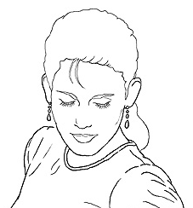
Edge detection
Goal: Identify sudden changes (discontinuities) in an image
Intuitively, most semantic and shape information from the image can be encoded in the edges
More compact than pixels
Ideal: artist’s line drawing (but artist is also using object-level knowledge)
Source: D. Lowe

Slide 3
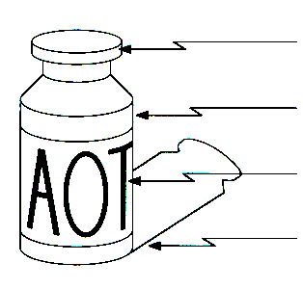
Origin of Edges
surface normal discontinuity
depth discontinuity
surface color discontinuity
illumination discontinuity
Edges are caused by a variety of factors
Source: Steve Seitz

Slide 4
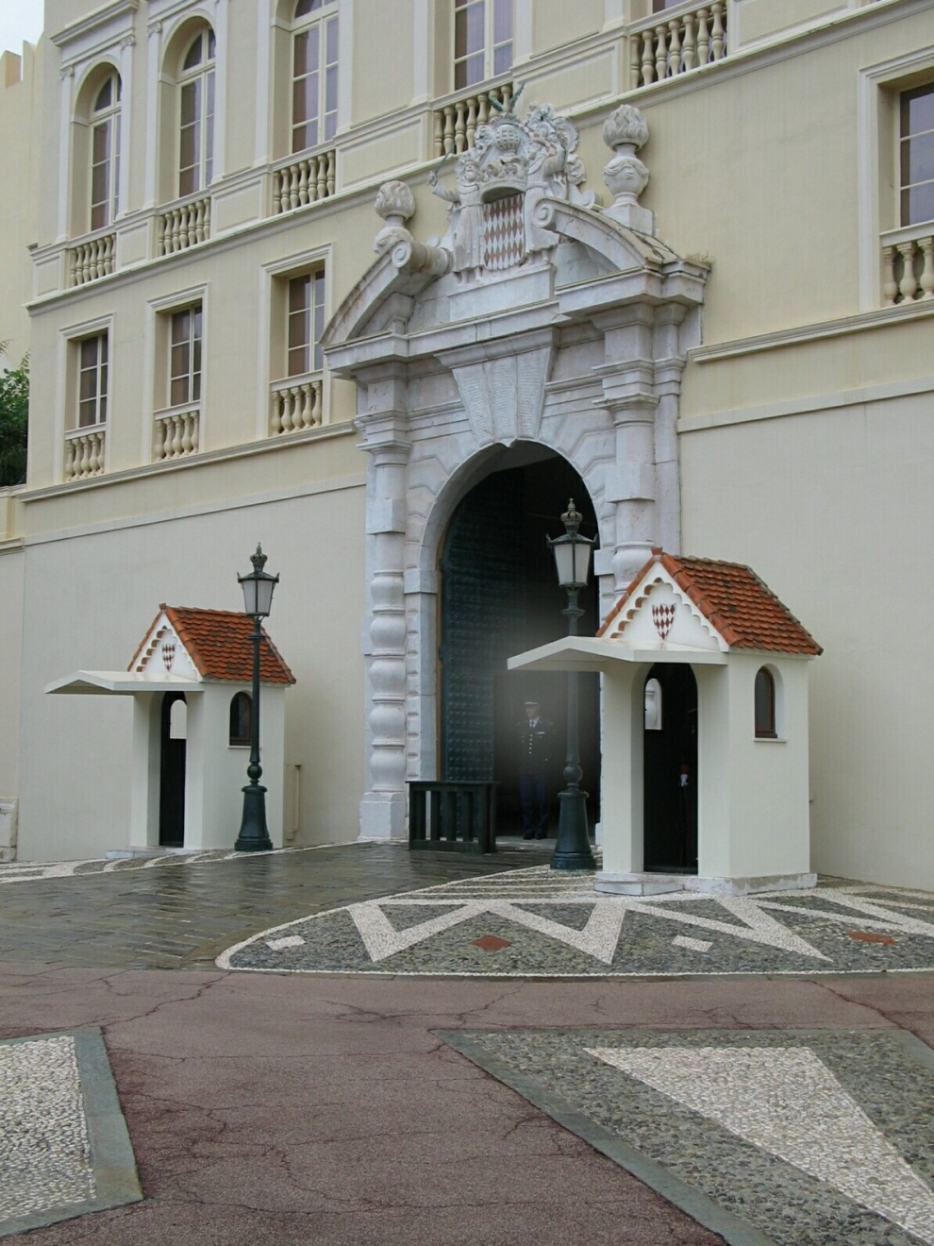
Closeup of edges
Source: D. Hoiem

Slide 5
Closeup of edges
Source: D. Hoiem

Slide 6
Closeup of edges
Source: D. Hoiem

Slide 7

Characterizing edges
An edge is a place of rapid change in the image intensity function
intensity function (along horizontal scanline)
image
first derivative
edges correspond to extrema of derivative

Slide 8
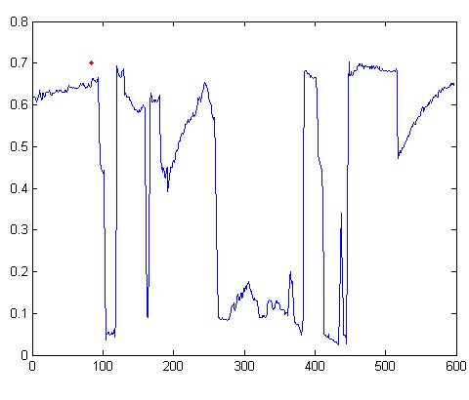

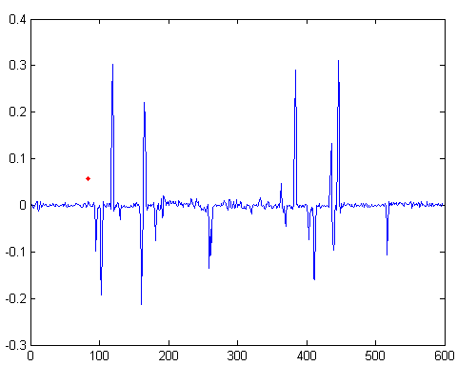
Intensity profile
Source: D. Hoiem

Slide 9
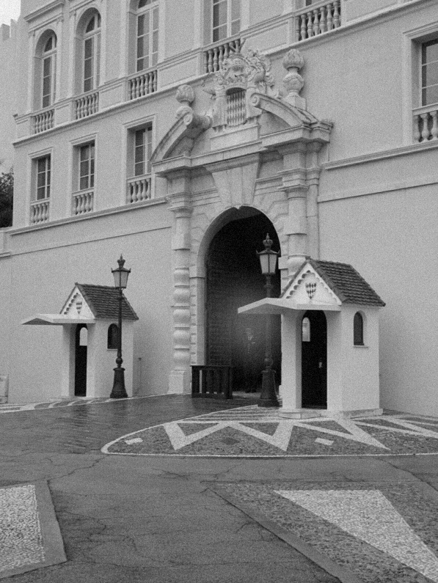
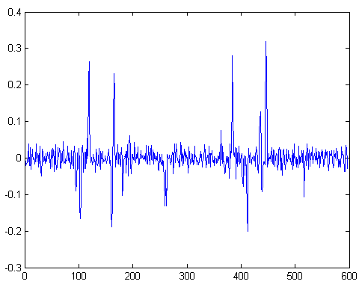
With a little Gaussian noise
Gradient
Source: D. Hoiem

Slide 10

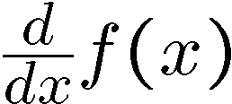
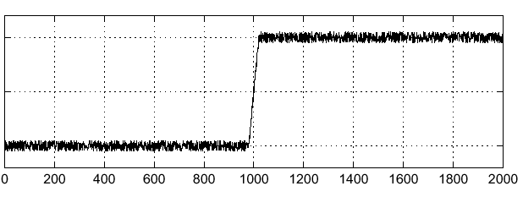
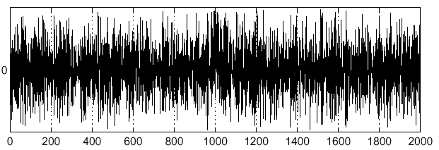
Effects of noise
Consider a single row or column of the image
Plotting intensity as a function of position gives a signal
Where is the edge?
Source: S. Seitz
Notes:
How to fix?

Slide 11
Effects of noise
Difference filters respond strongly to noise
Image noise results in pixels that look very different from their neighbors
Generally, the larger the noise the stronger the response
What can we do about it?
Source: D. Forsyth

Slide 12
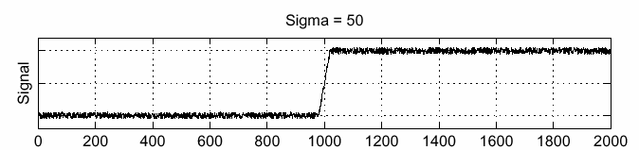
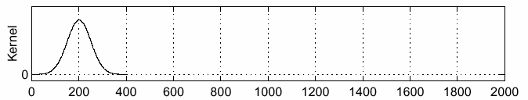
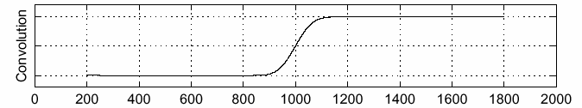
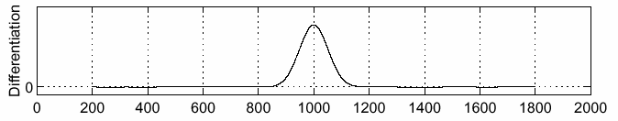
Solution: smooth first
f
g
f * g
To find edges, look for peaks in
Source: S. Seitz

Slide 13
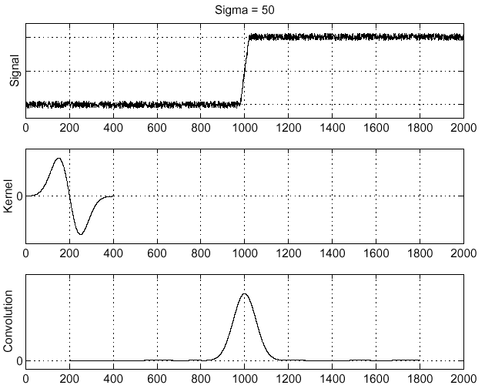
Derivative theorem of convolution
Differentiation is convolution, and convolution is associative:
This saves us one operation:
f
Source: S. Seitz

Slide 14
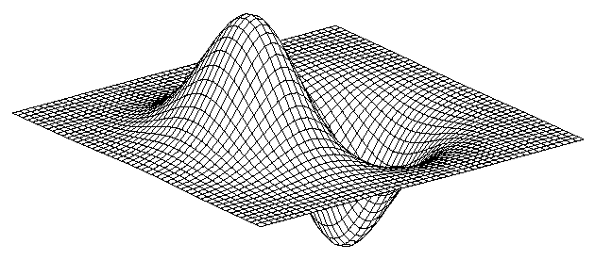
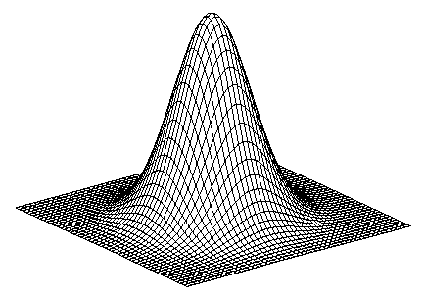
Derivative of Gaussian filter
* [1 -1] =
Notes:
Is this filter separable?

Slide 15
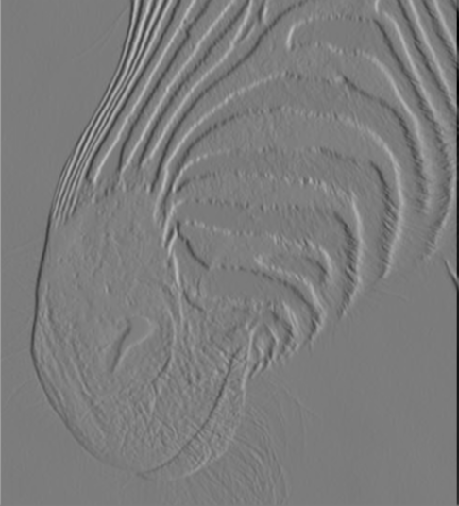
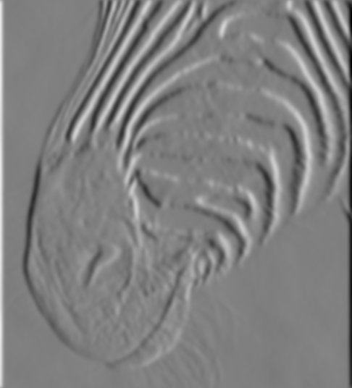
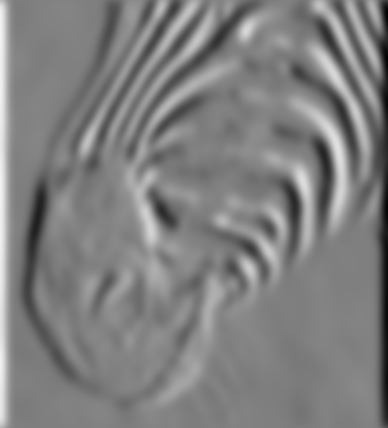
Tradeoff between smoothing and localization
1 pixel
3 pixels
7 pixels
Smoothed derivative removes noise, but blurs edge. Also finds edges at different “scales”.
Source: D. Forsyth

Slide 16
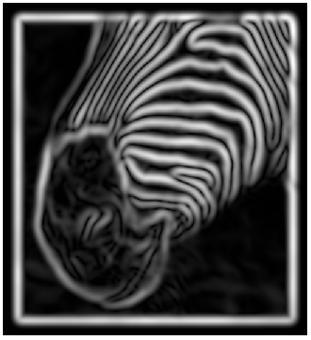
Implementation issues
The gradient magnitude is large along a thick “trail” or “ridge,” so how do we identify the actual edge points?
How do we link the edge points to form curves?
Source: D. Forsyth
Notes:
Figures show gradient magnitude of zebra at two different scales

Slide 17
Designing an edge detector
Criteria for a good edge detector:
Good detection: the optimal detector should find all real edges, ignoring noise or other artifacts
Good localization
the edges detected must be as close as possible to the true edges
the detector must return one point only for each true edge point
Cues of edge detection
Differences in color, intensity, or texture across the boundary
Continuity and closure
High-level knowledge
Source: L. Fei-Fei

Slide 18
Canny edge detector
This is probably the most widely used edge detector in computer vision
Theoretical model: step-edges corrupted by additive Gaussian noise
Canny has shown that the first derivative of the Gaussian closely approximates the operator that optimizes the product of signal-to-noise ratio and localization
J. Canny, A Computational Approach To Edge Detection, IEEE Trans. Pattern Analysis and Machine Intelligence, 8:679-714, 1986.
Source: L. Fei-Fei

Slide 19

Example
original image (Lena)

Slide 20
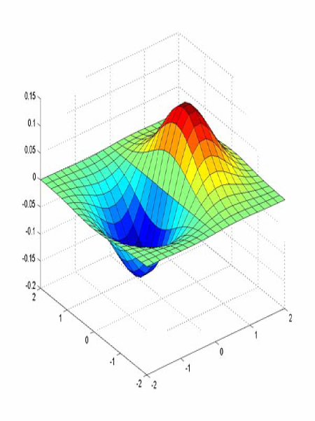
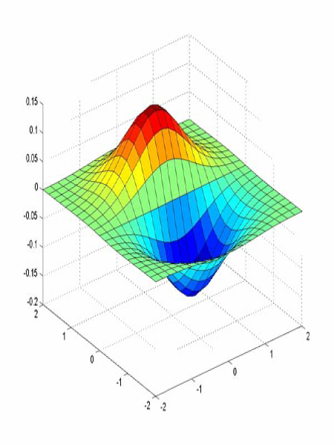
Derivative of Gaussian filter
x-direction
y-direction

Slide 21
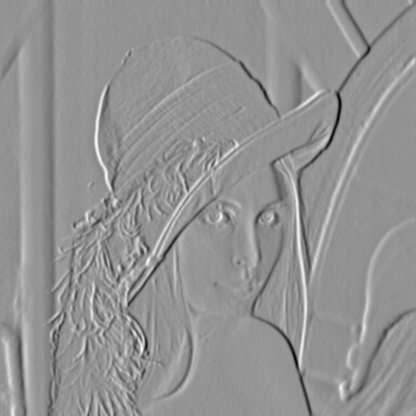
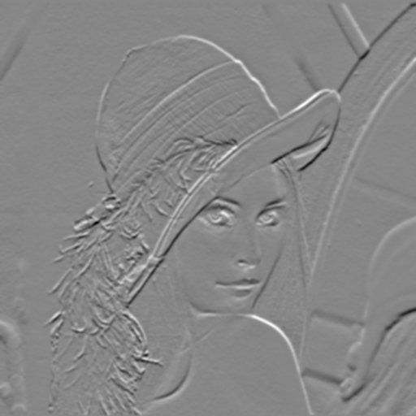
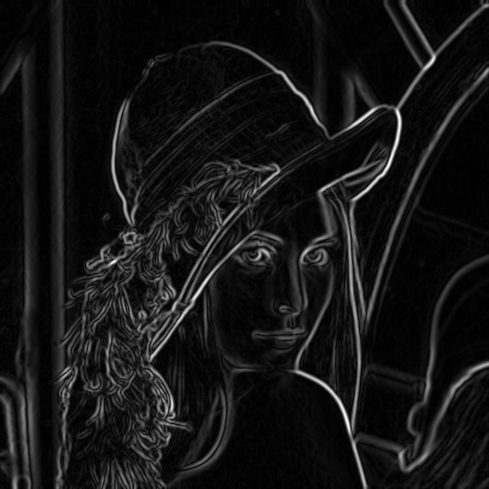
Compute Gradients (DoG)
X-Derivative of Gaussian
Y-Derivative of Gaussian
Gradient Magnitude

Slide 22
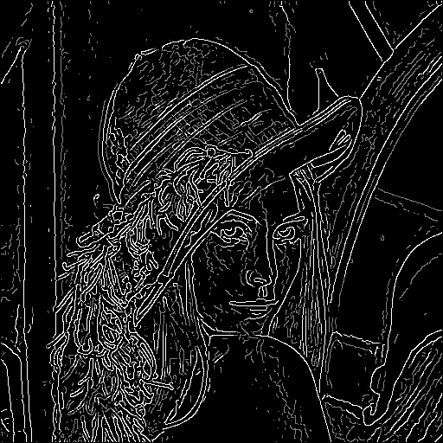
Hysteresis thresholding
Threshold at low/high levels to get weak/strong edge pixels
Do connected components, starting from strong edge pixels

Slide 23
Hysteresis thresholding
Check that maximum value of gradient value is sufficiently large
drop-outs? use hysteresis
use a high threshold to start edge curves and a low threshold to continue them.
Source: S. Seitz

Slide 24
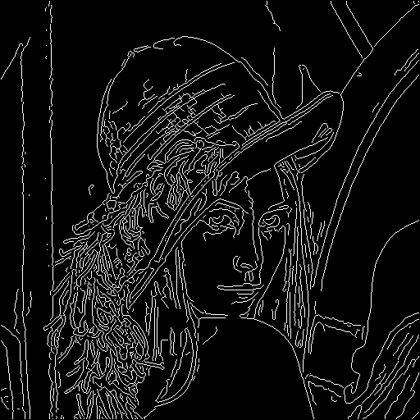
Final Canny Edges

Slide 25
Canny edge detector
Filter image with x, y derivatives of Gaussian
Find magnitude and orientation of gradient
Non-maximum suppression:
Thin multi-pixel wide “ridges” down to single pixel width
Thresholding and linking (hysteresis):
Define two thresholds: low and high
Use the high threshold to start edge curves and the low threshold to continue them
MATLAB: edge(image, ‘canny’)
Source: D. Lowe, L. Fei-Fei

Slide 26

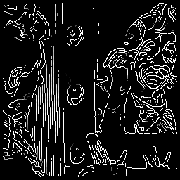



Effect of σ (Gaussian kernel spread/size)
original
Canny with
Canny with
The choice of σ depends on desired behavior
large σ detects large scale edges
small σ detects fine features
Source: S. Seitz

Slide 27
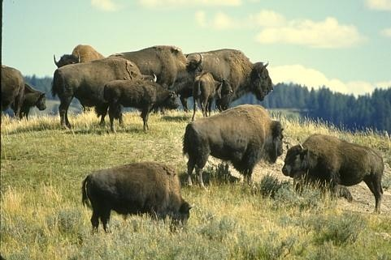
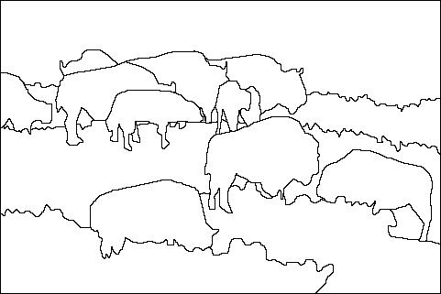
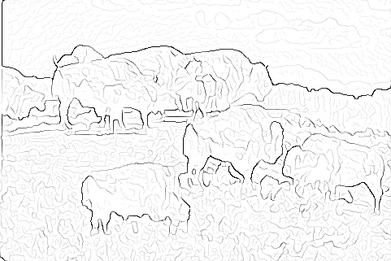

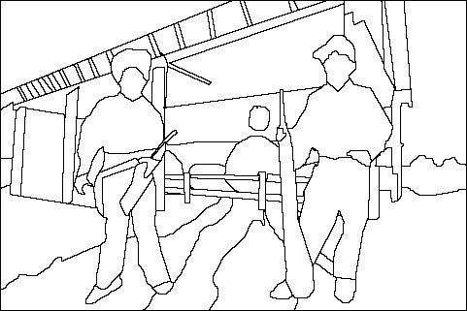
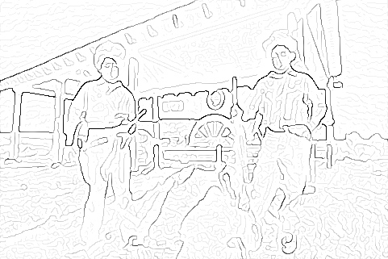
Where do humans see boundaries?
image
human segmentation
gradient magnitude
Berkeley segmentation database: http://www.eecs.berkeley.edu/Research/Projects/CS/vision/grouping/segbench/

Slide 28
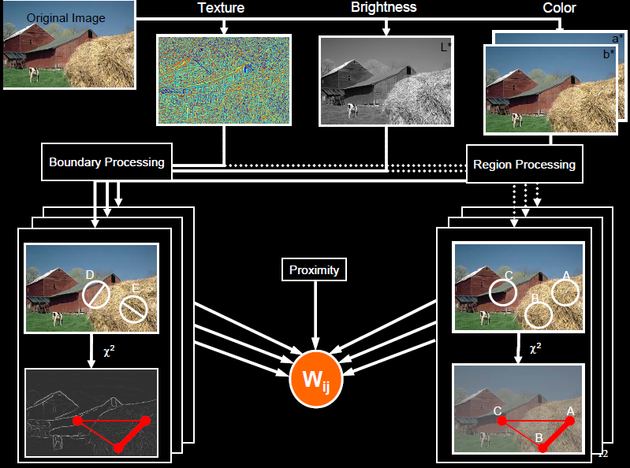
pB boundary detector
Martin, Fowlkes, Malik 2004: Learning to Detect Natural Boundaries…
http://www.eecs.berkeley.edu/Research/Projects/CS/vision/grouping/papers/mfm-pami-boundary.pdf
Figure from Fowlkes

Slide 29
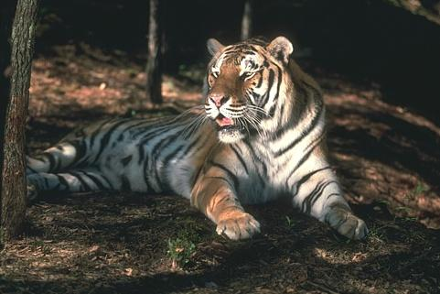
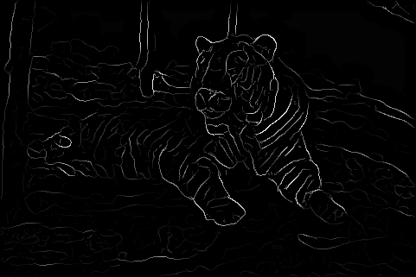
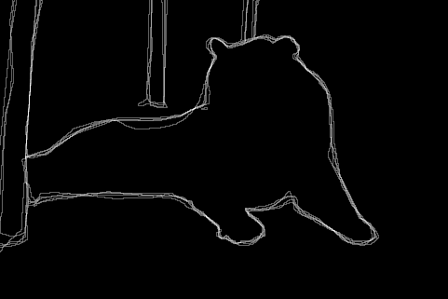
Pb (0.35)
Human (0.90)
For more: http://www.eecs.berkeley.edu/Research/Projects/CS/vision/bsds/bench/html/108082-color.html

